Slide 1
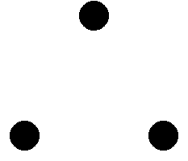
Argument
An argument is a sequence of statements.
All statements but the final one are called assumptions or hypothesis.
The final statement is called the conclusion.
An argument is valid if:
whenever all the assumptions are true, then the conclusion is true.
If today is Wednesday, then yesterday is Tuesday.
Today is Wednesday.
Yesterday is Tuesday.

Slide 2
Modus Ponens
If p then q.
p
q
If typhoon, then class cancelled.
Typhoon.
Class cancelled.
assumptions
conclusion
p | q | p→q | p | q
T | T | T | T | T
T | F | F | T | F
F | T | T | F | T
F | F | T | F | F
Modus ponens is Latin meaning “method of affirming”.

Slide 3
Modus Tollens
If p then q.
~q
~p
If typhoon, then class cancelled.
Class not cancelled.
No typhoon.
assumptions
conclusion
p | q | p→q | ~q | ~p
T | T | T | F | F
T | F | F | T | F
F | T | T | F | T
F | F | T | T | T
Modus tollens is Latin meaning “method of denying”.

Slide 4
Equivalence
A student is trying to prove that propositions P, Q, and R are all true.
She proceeds as follows.
First, she proves three facts:
P implies Q
Q implies R
R implies P.
Then she concludes,
``Thus P, Q, and R are all true.''
Proposed argument:
assumption
Is it valid?
conclusion

Slide 5


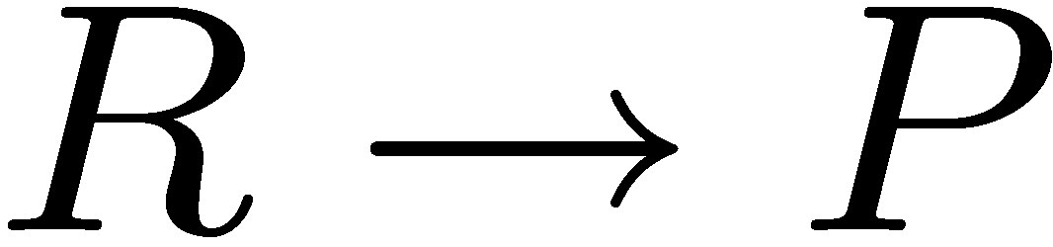

Valid Argument?
Is it valid?
assumptions
conclusion
P | Q | R
T | T | T
T | T | F
T | F | T
T | F | F
F | T | T
F | T | F
F | F | T
F | F | F
T | T | T
T | F | T
F | T | T
F | T | T
T | T | F
T | F | T
T | T | F
T | T | T
 | OK?
T | yes
F | yes
F | yes
F | yes
F | yes
F | yes
F | yes
F | no
To prove an argument is not valid, we just need to find a counterexample.

Slide 6
Valid Arguments?
assumptions
conclusion
p | q | p→q | q | p
T | T | T | T | T
T | F | F | F | T
F | T | T | T | F
F | F | T | F | F
If p then q.
q
p
Assumptions are true, but not the conclusion.
If you are a fish, then you drink water.
You drink water.
You are a fish.

Slide 7
Valid Arguments?
assumptions
conclusion
p | q | p→q | ~p | ~q
T | T | T | F | F
T | F | F | F | T
F | T | T | T | F
F | F | T | T | T
If p then q.
~p
~q
If you are a fish, then you drink water.
You are not a fish.
You do not drink water.

Slide 8
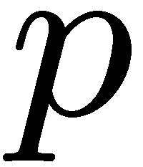
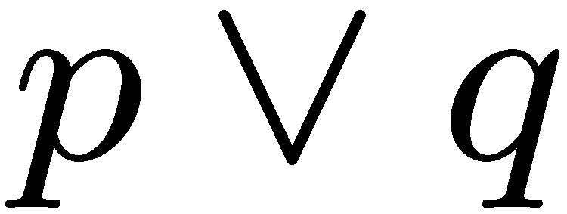
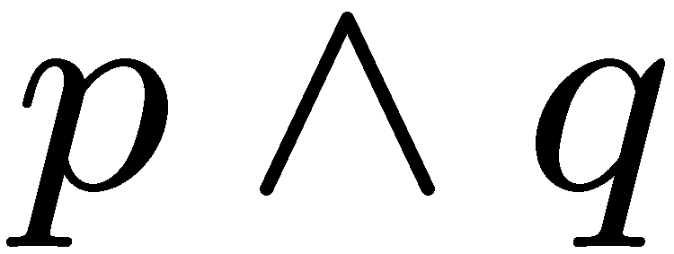
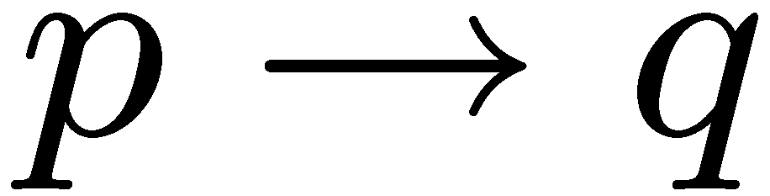
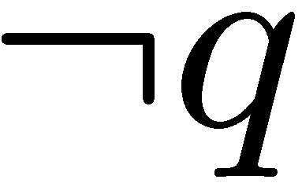
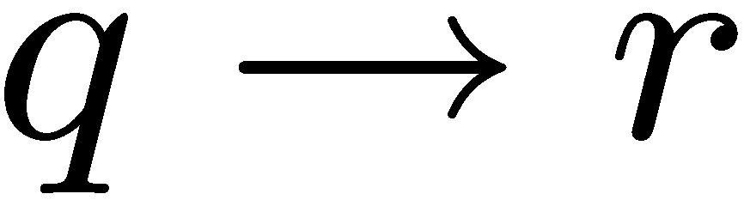
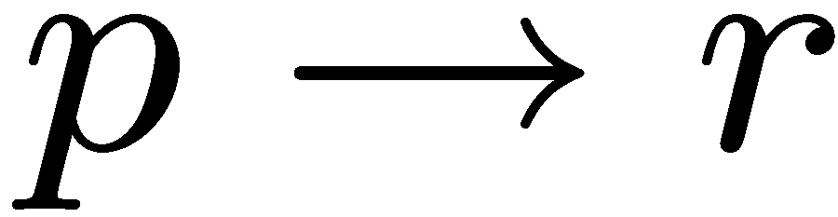
Exercises

Slide 9
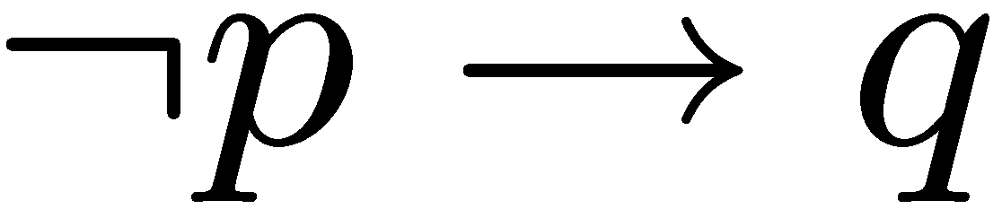
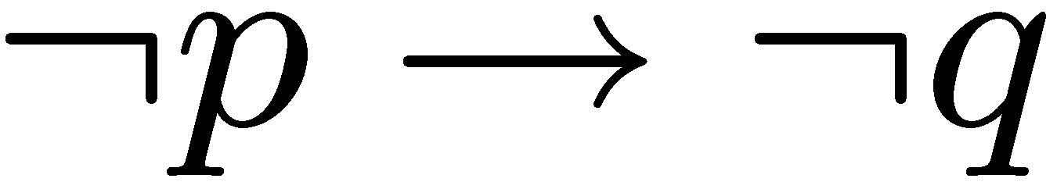
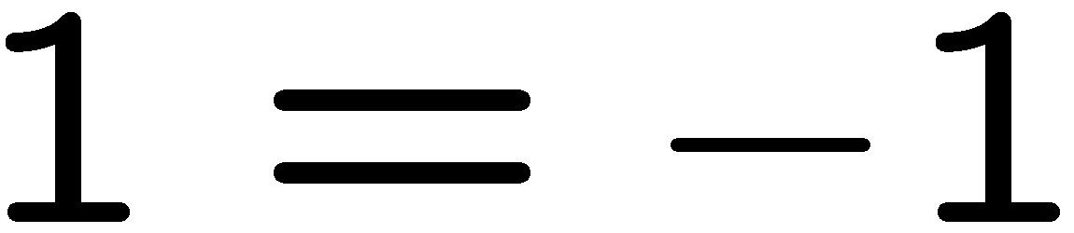
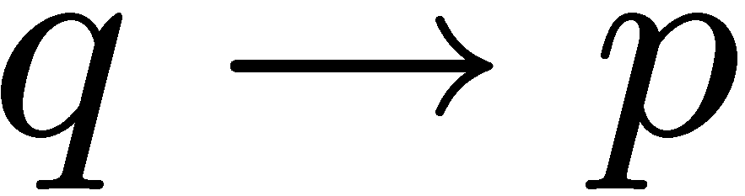
More Exercises
Valid argument True conclusion
True conclusion Valid argument

Slide 10
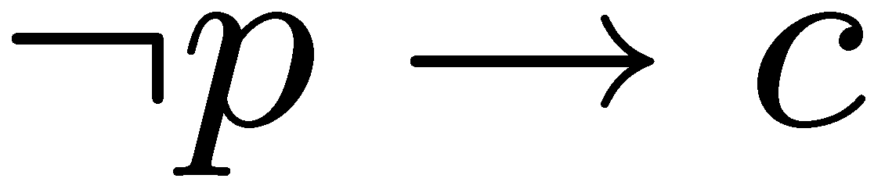
Contradiction
If you can show that the assumption that the statement
p is false leads logically to a contradiction,
then you can conclude that p is true.
This is similar to the method of denying (modus tollens)

Slide 11
Knights and Knaves
Knights always tell the truth.
Knaves always lie.
A says: B is a knight.
B says: A and I are of opposite type.
Suppose A is a knight.
Then B is a knight (because what A says is true).
Then A is a knave (because what B says is true)
A contradiction.
So A must be a knave.
So B must be a knave (because what A says is false).

Slide 12
Quick Summary
Arguments
definition of a valid argument
method of affirming, denying, contradiction
Key points:
Make sure you understand conditional statements and contrapositive.
Make sure you can check whether an argument is valid.

